Slide 1

HarvestHub
Community Allotment Management Application
GitHub Repository Link: https://github.com/dmoonmake/HarvestHub

Slide 2

Contents
Purpose of HarvestHub
Architecture Diagram
Technology Choices
Code Documentation
Functional Testing and Test Data
Screenshots of Web Application
Changes Compared to Concepting
Screencast Video

Slide 3
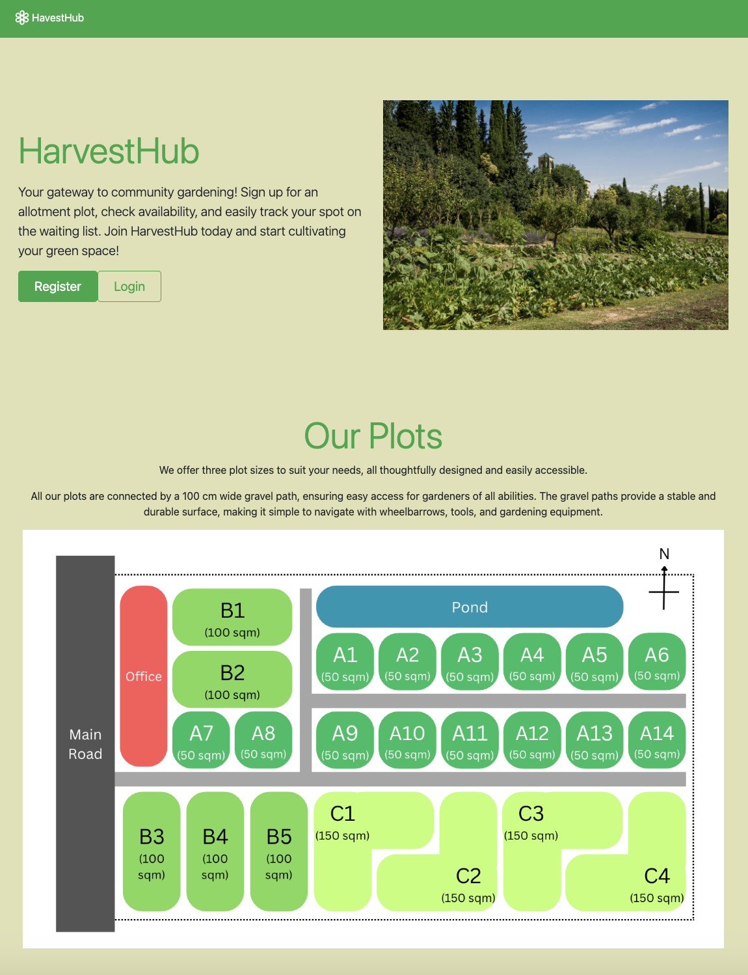
Purpose of HarvestHub
HarvestHub is a digital platform designed to ease the management of allotment communities.
With HarvestHub, users are always in the know. They can register for plots of their interest, check their position on the waiting list, and accept or remove their plot request. The platform's plot status updates ensure transparency, providing users with the latest information and instilling confidence in the process.
HarvestHub also simplifies administrative tasks, efficiently manages user registrations and plot assignments, and quickly updates the plot status. It also reduces manual work and paperwork, so admins can easily manage all these tasks.

Slide 4
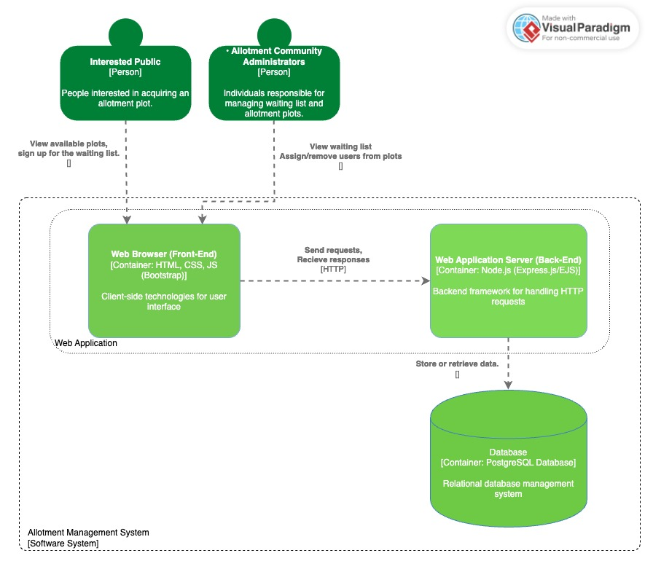
Architecture Diagram
Present here is C4 Level 2: Container Diagram
Web Application
HTML/CSS/JavaScript (Bootstrap): Frontend technologies for the user interface.
Node.js (Express.js/ EJS): Backend framework for handling HTTP requests.
Database Container
PostgreSQL: Relational database management system.

Slide 5
Technology Choices
Ease of Learning and Use: HTML, CSS, and JavaScript are fundamental technologies that are easy to use and widely supported, making them perfect for front-end development.
Harmonious Language: Using JavaScript for both the front and back end streamlines the development process to promote code reuse and a unified development environment.
Extensibility and Community Support: Both Node.js and PostgreSQL have comprehensive libraries, reducing development time and increasing the availability of support and resources.
Robust Data Management: PostgreSQL's advanced features and substantial compliance with ACID properties ensure reliable and robust data management, essential for any application handling user data.
Dynamic Content Generation: EJS enables dynamic content generation on the server-side, allowing for the creation of reusable templates with embedded JavaScript logic.
Frontend: HTML, CSS (Bootstrap), JavaScript
Backend: Node.js (Express.js/EJS)
Database: PostgreSQL

Slide 6
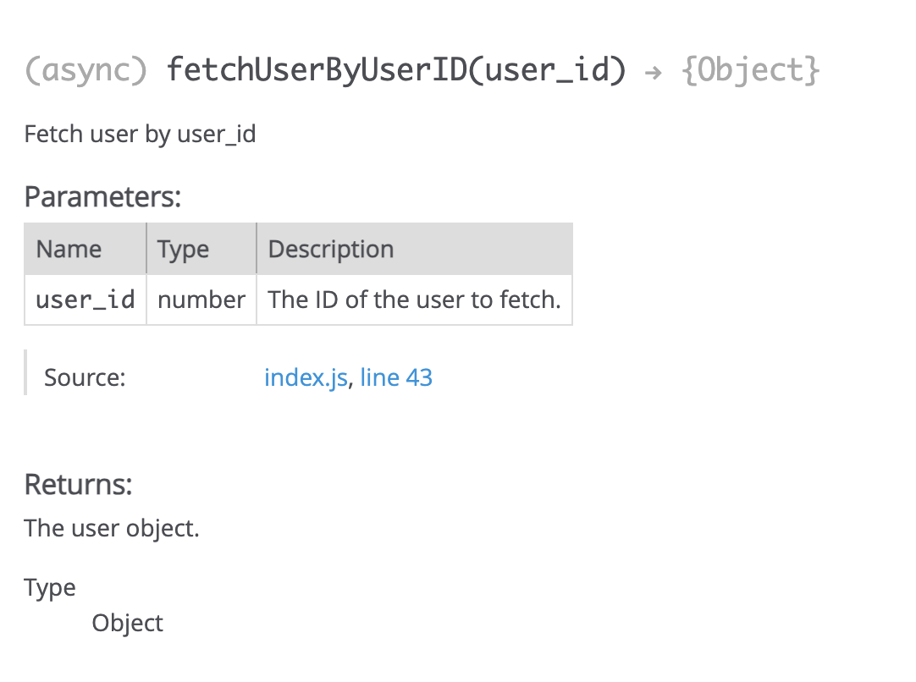
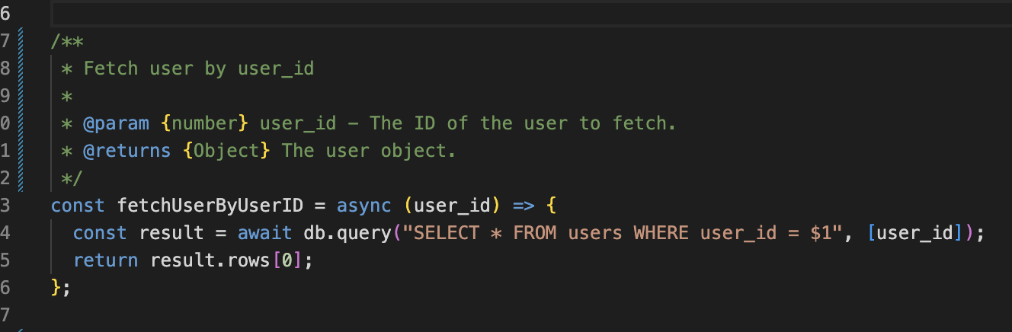
Code Documentation
HarvestHub chose the JSCode tool to document code, prioritising:
Clarity: Ensures a clear understanding of code functionality.
Maintenance: Simplifies debugging and updating.
Collaboration: Promotes understanding and collaboration.
Knowledge Transfer: Assists faster onboarding of new team members.
Documented Code Example:

Slide 7
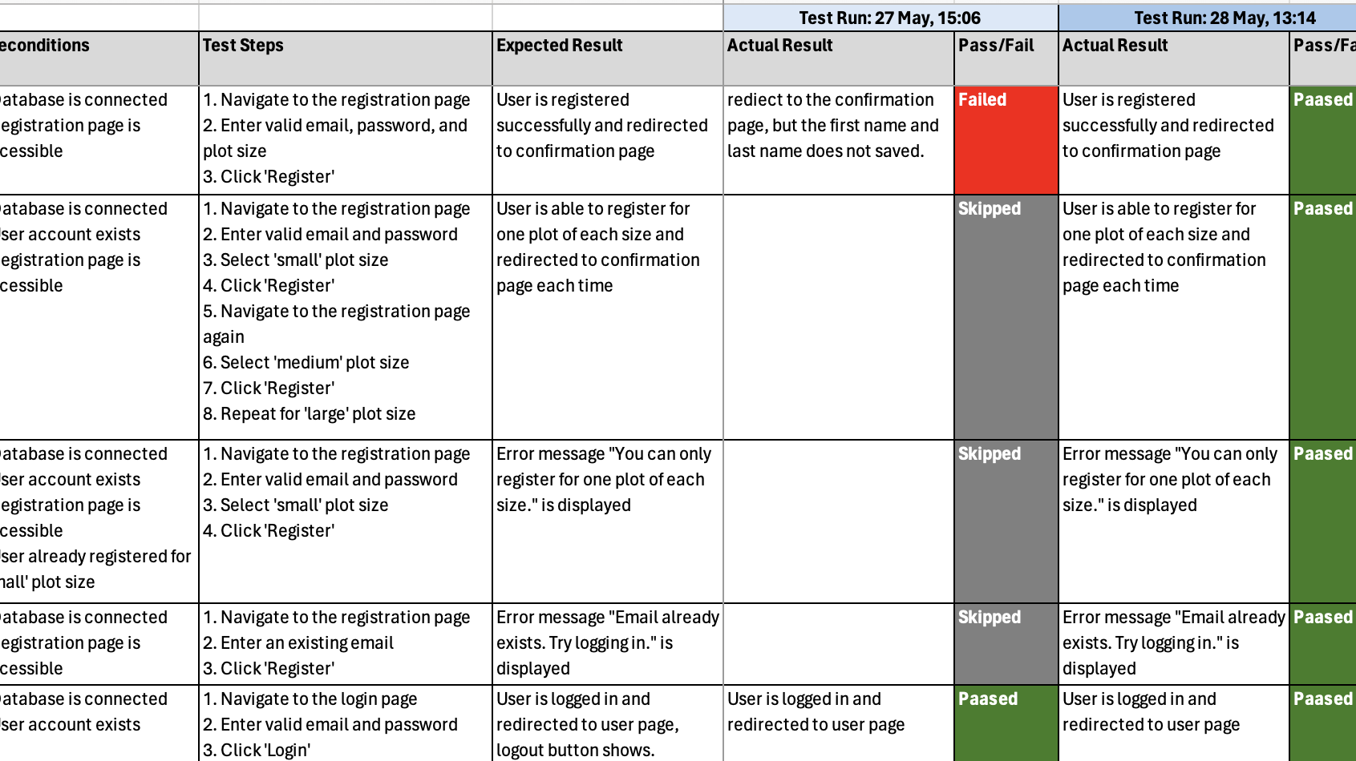

Functional Testing and Test Data
!! Run this test cases only after DB setup according to README instructions !!
To ensure our application meets requirements, we need to perform functional testing and focus on features and functionalities to identify defects early.
Approach: Manual testing with Black-box methodology
Test Data:
Admin - Username: admin1@example.com, Password: 123456
Admin - Username: admin2@example.com, Password: 123456
User - Username: user1@example.com, Password: 123456
User - Username: user2@example.com, Password: 123456
Test cases can be found
at the below Excel worksheet:

Slide 8
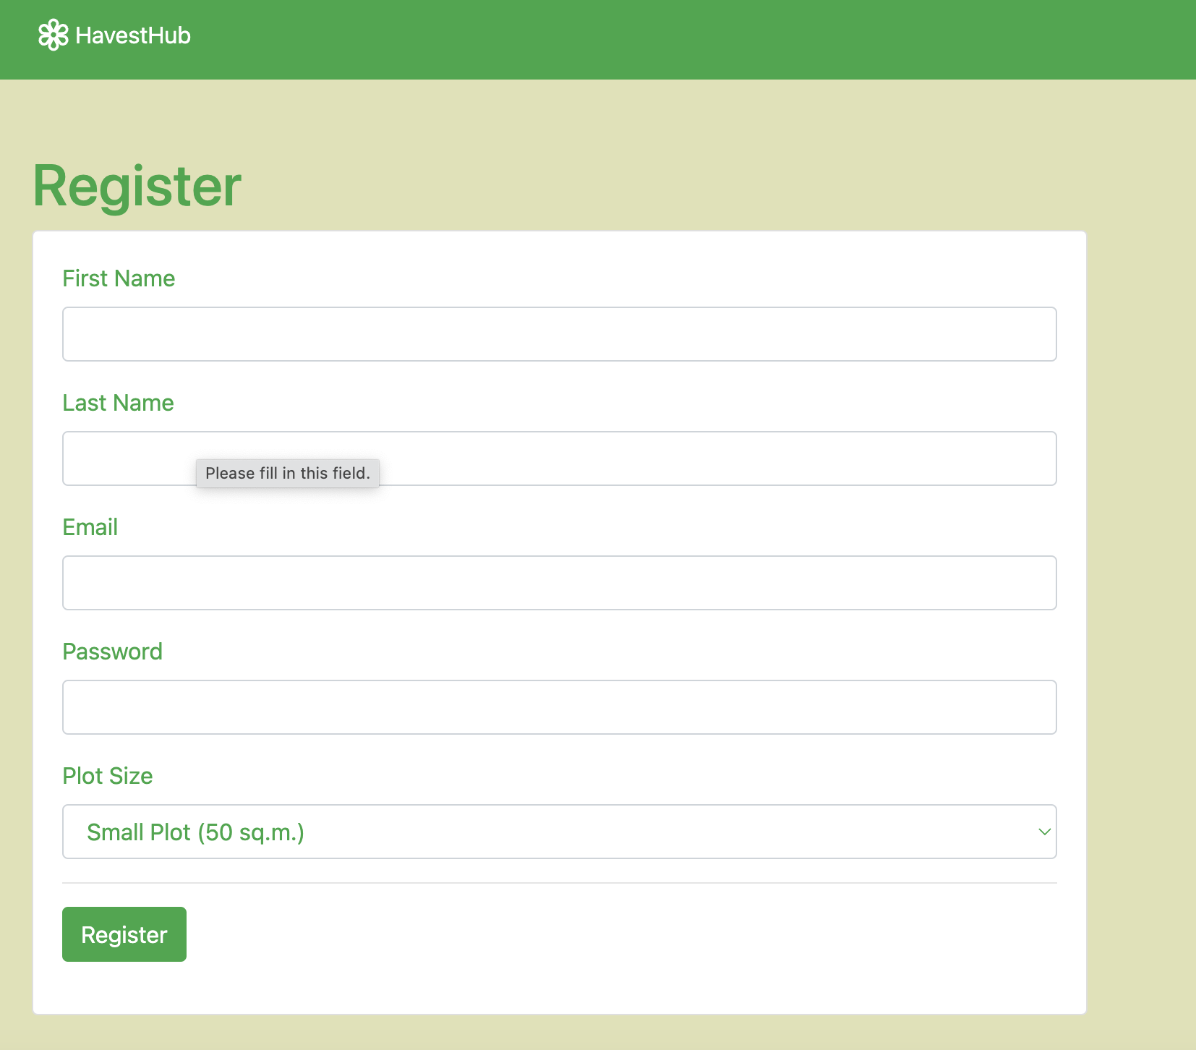
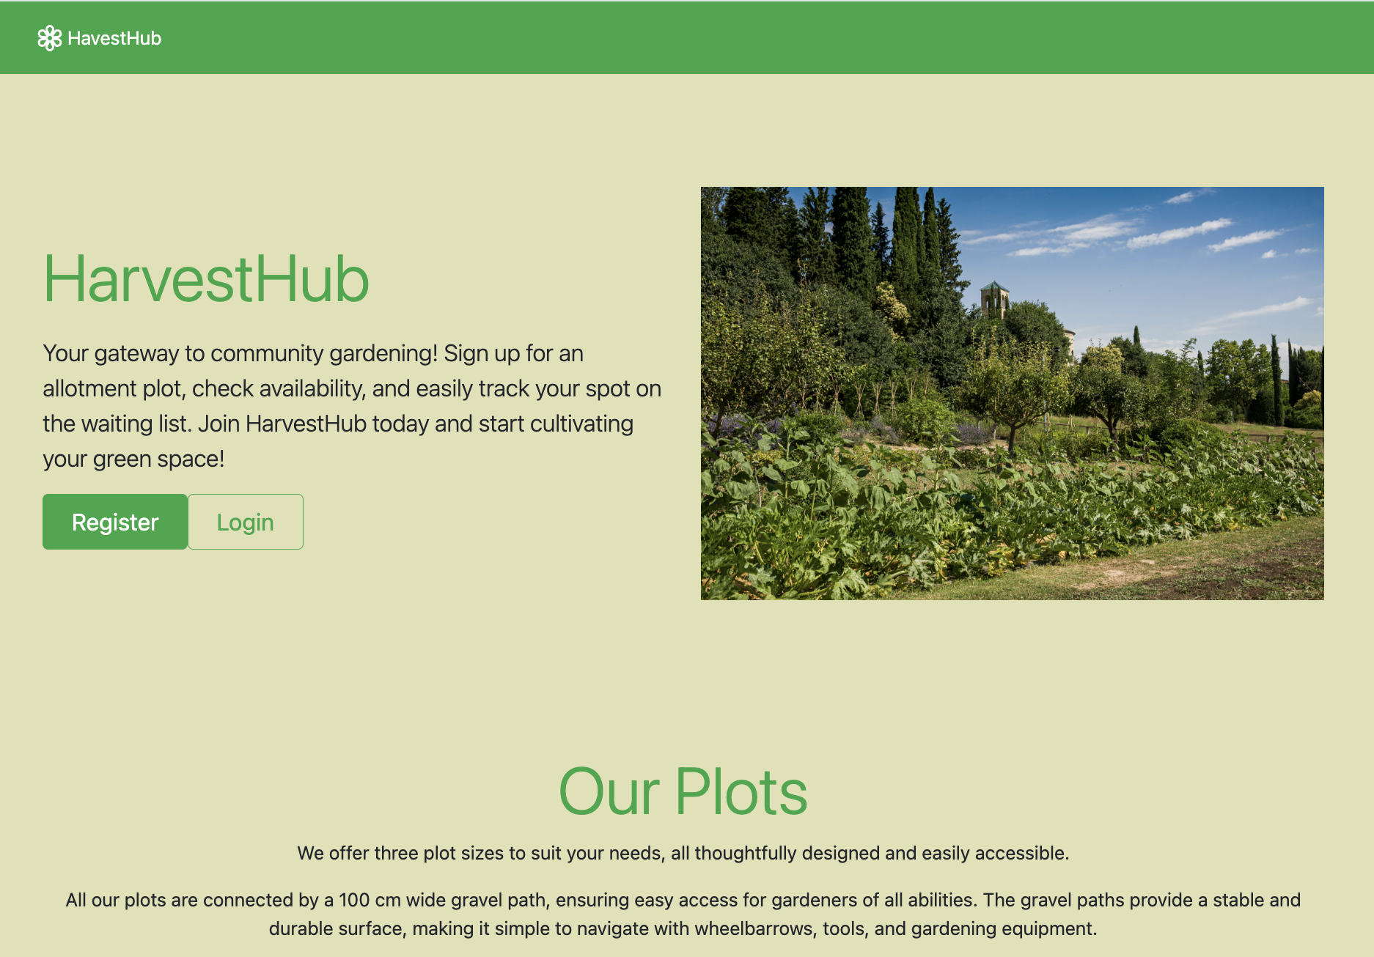
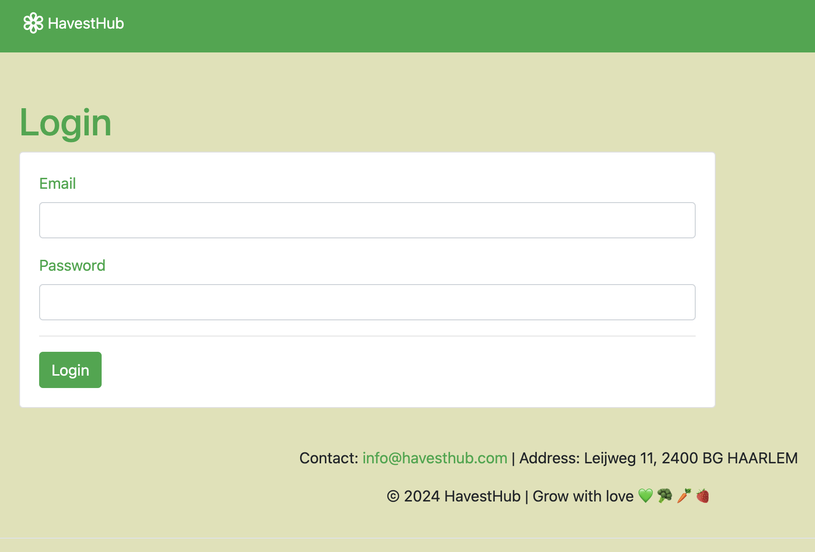
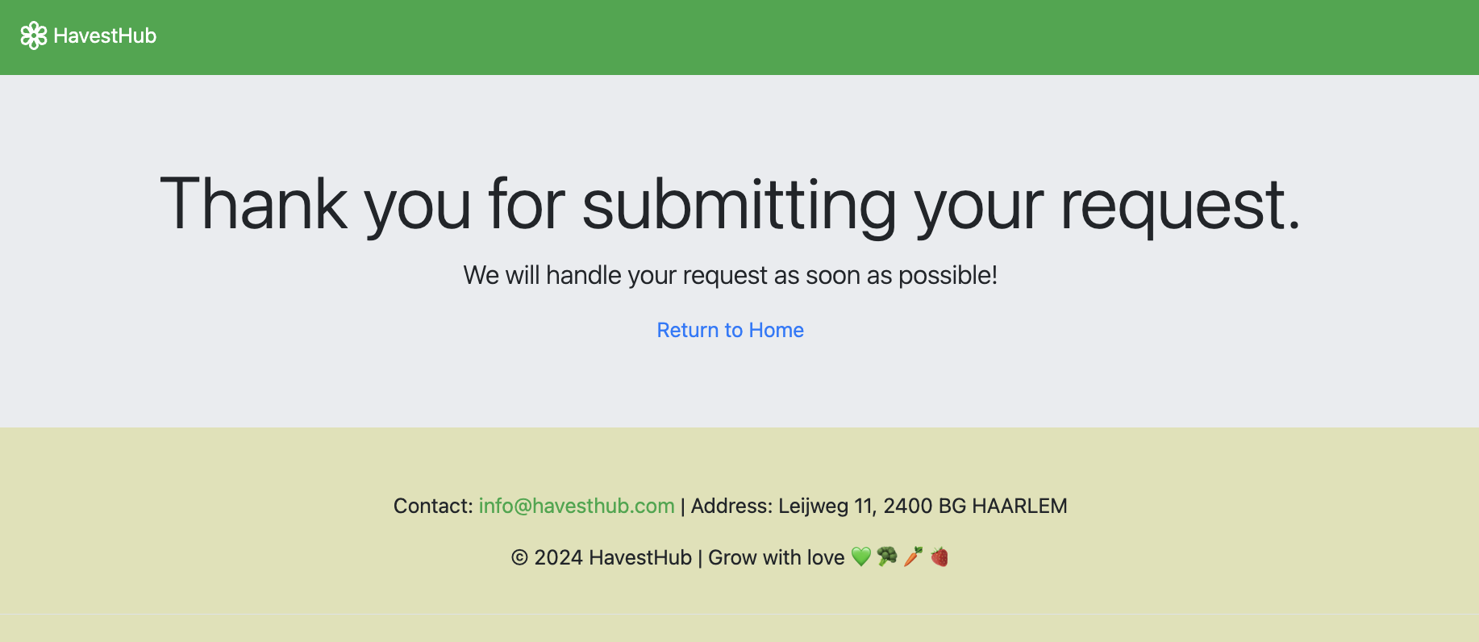
Screenshots of Web Application (1)
Here are screenshots of the homepage (top left), registration (top right), login (bottom left), and confirmation pages after registration (bottom right).

Slide 9
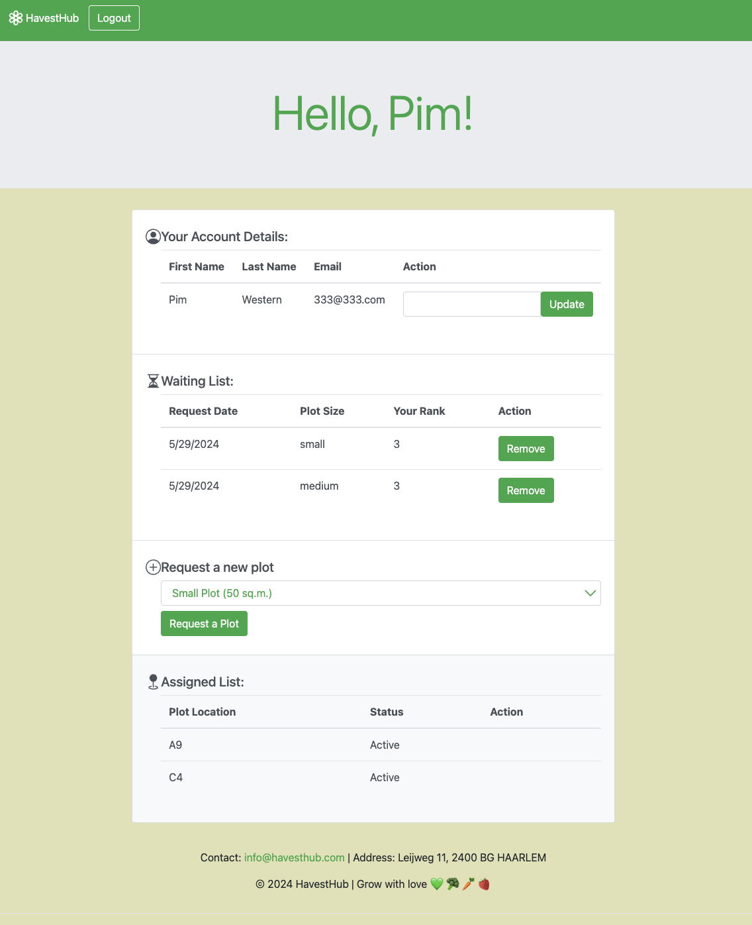
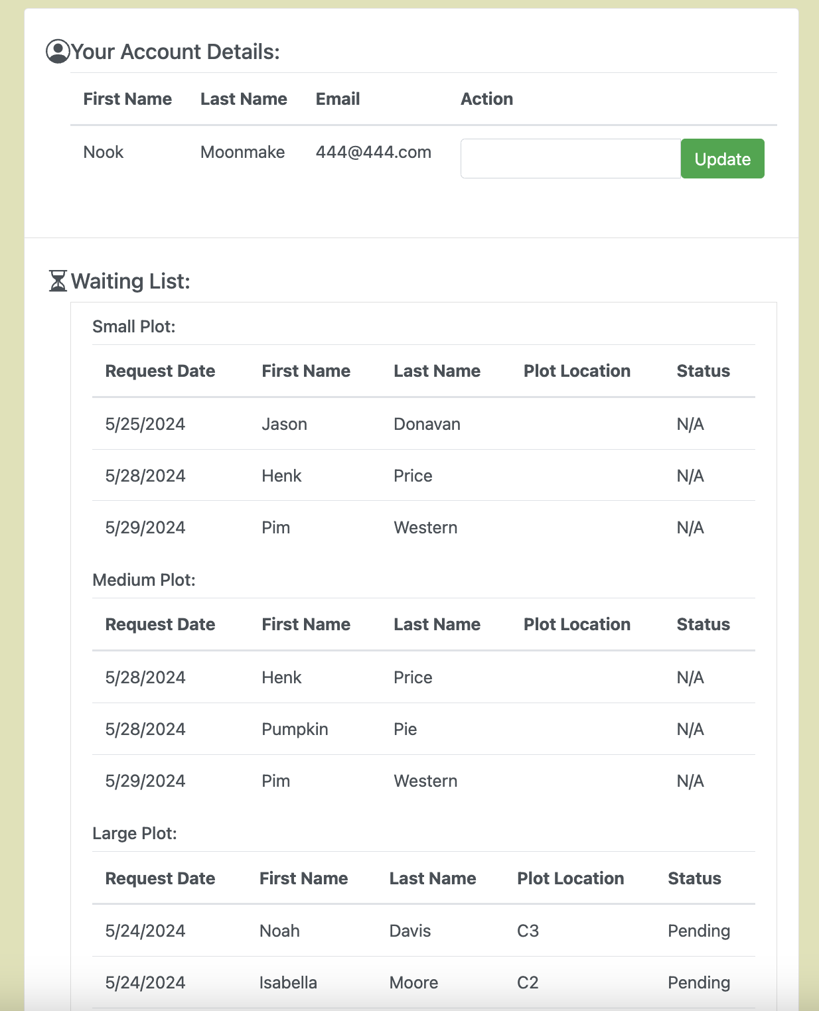
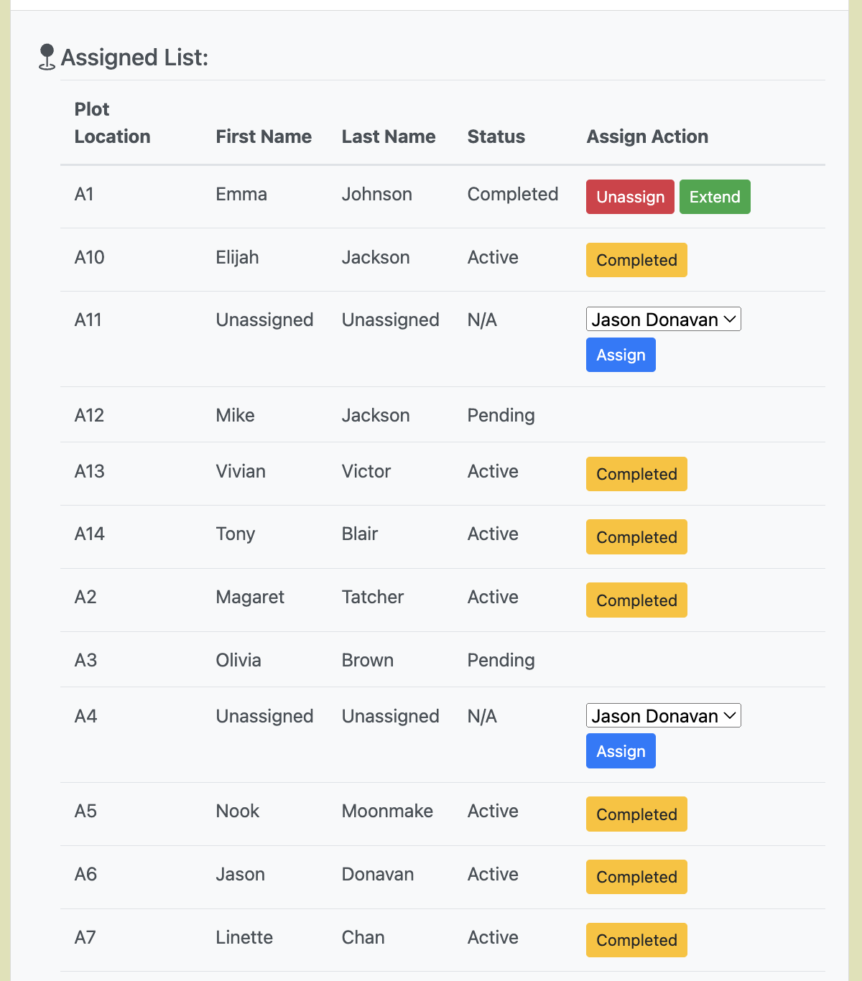
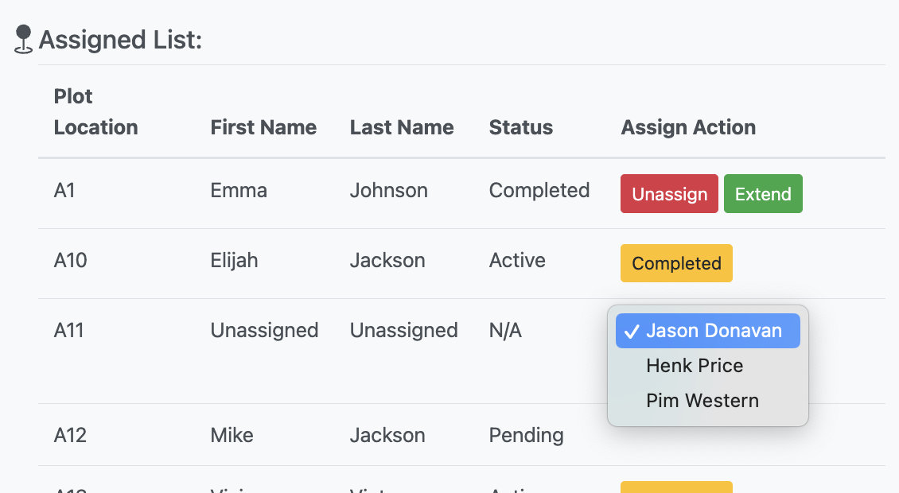
Screenshots of Web Application (2)
Here are screenshots of the user dashboard(top left), the admin dashboard with account management and waiting list (top right), the admin dashboard for assignment management (bottom left), and the assignment process (bottom right).
Assignment Status Explanation
Null
Unassigned Plot
Pending
Assigned but waiting for user confirmation
Active
Assigned and user confirmed
Completed
Assignment completed the term, waiting for either unassign or extension

Slide 10
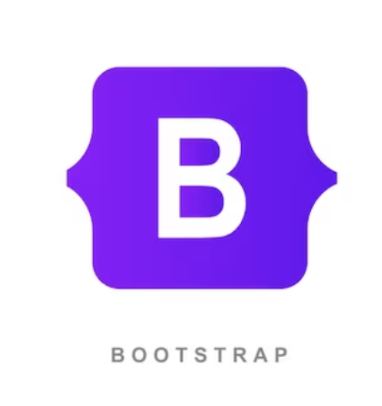


Changes Compared to Concepting
The technology that was previously selected remains the same for this project. However, HarvestHub adopted the following frameworks during the implementation phase.
Bootstrap:
Provides pre-designed components that help create a responsive website.
Speeds up the development process because the custom CSS needed is less.
Express.js:
Simplified route handling, middleware, and HTTP requests.
Organises backend code better into modular, making it easier to maintain.
EJS (Embedded JavaScript):
Enables dynamic HTML rendering on the server side, making it easier to manage and generate HTML content.

Slide 11

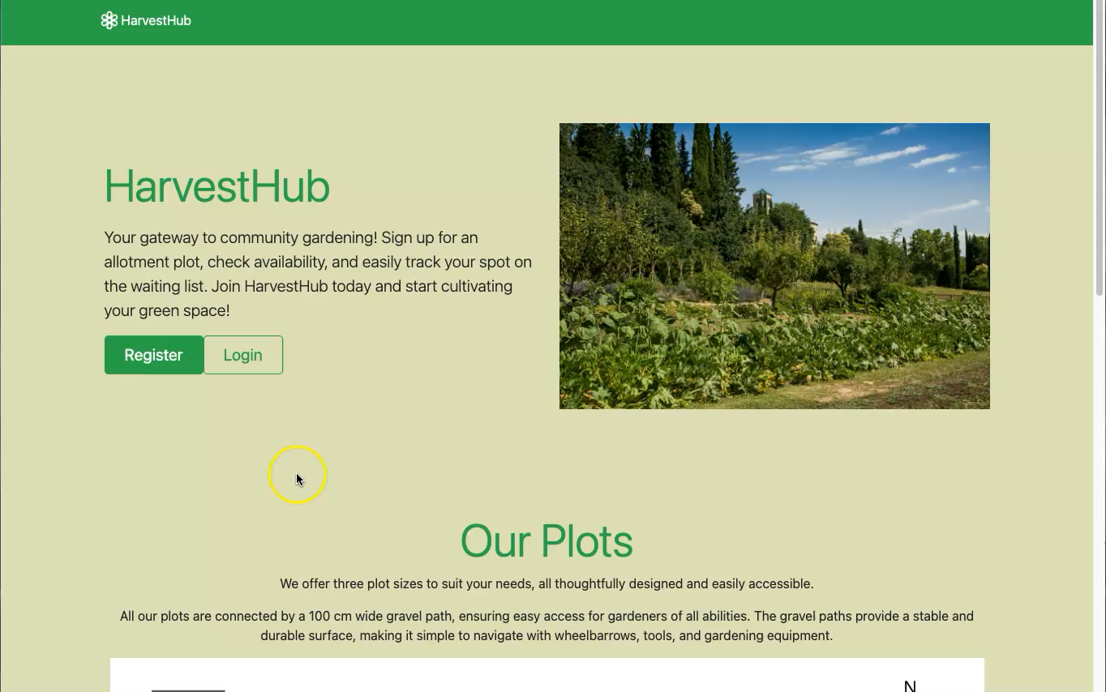
Screencast Video

